Slide 1
Introduction to D3D11
DirectX Day 1

Slide 2
What is a 3D Graphics API?
Abstracts low-level rasterization operations.
Drawing of polygons and texture mapping of those polygons.
Two main types:
Hardware accelerated. (Direct3D, OpenGL)
Software based. (Pixomatic, Reference Rasterizers)
D3D is a Hardware Accelerated Rendering API.
Microsoft designs the specifications, GPU manufactures support the feature set in their hardware.
Device Drivers hide the card specific implementation from the programmer. (You talk to D3D, D3D talks to your card via the driver)

Slide 3
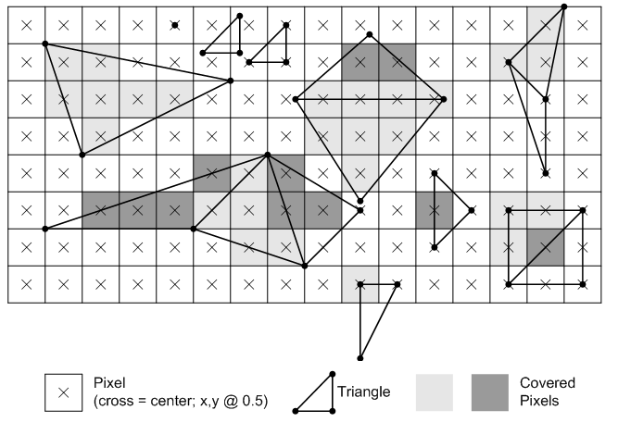
What is Rasterization?
Rasterization is the conversion of vector data. (think mathematical shapes) Into raster data. (think screen pixels)
The D3D11 API is designed to command hardware that is specifically designed to do this very very quickly.
The reason it is so fast, is because the graphics hardware is comprised of hundreds if not thousands of processors designed to perform these sorts of tasks in parallel.

Slide 4
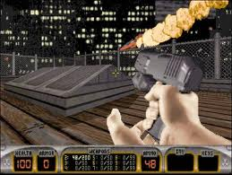

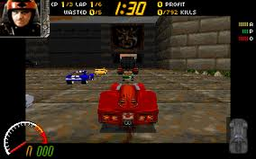

The Early Days: Software Rasterization
Software 3D rendering only, Early-Mid 90’s and before.
The CPU handled all polygon drawing & texture mapping.
Many tricks and shortcuts to get acceptable frame rates.

Slide 5
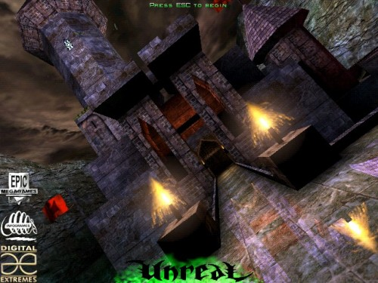
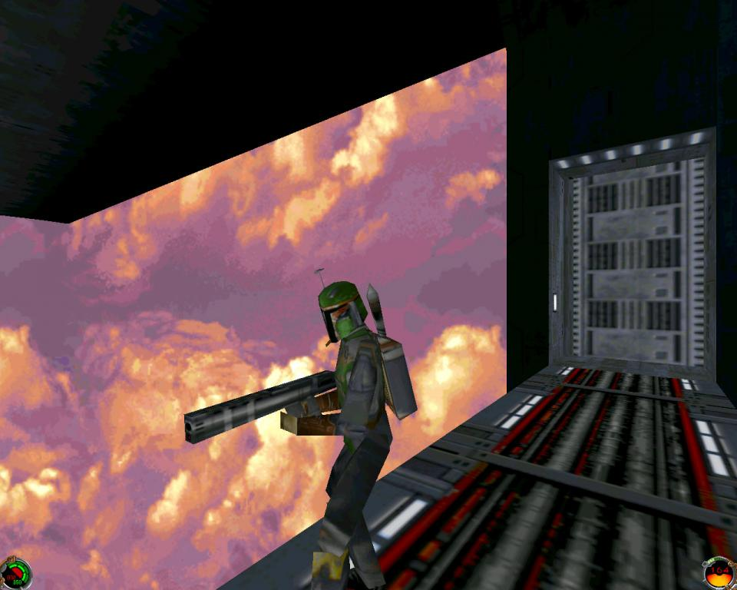

The Revolution: 3D Hardware Acceleration
Consumer 3D video cards become the norm during the Mid to Late 90’s and after.
3dfx Voodoo graphics leads the way.
Nvidia & ATI become the major players.
Hardware Transformation & Lighting allowed developers to push way more polygons than ever before at higher quality.

Slide 6
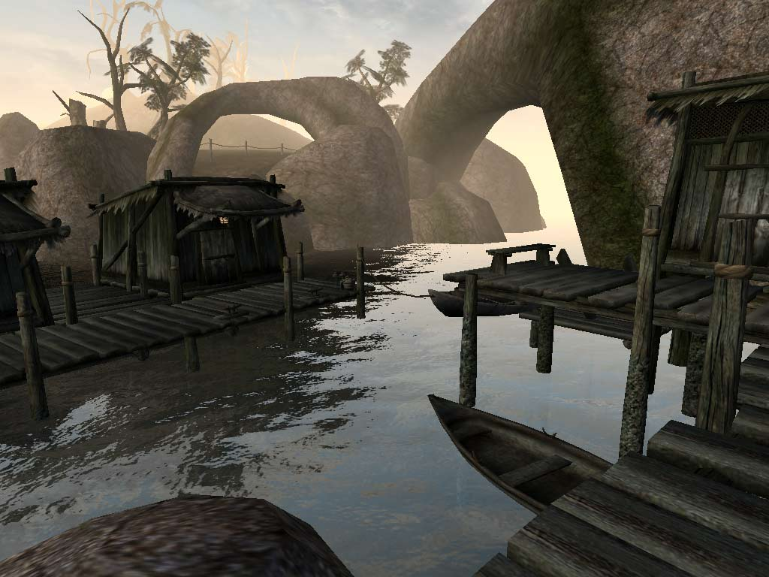
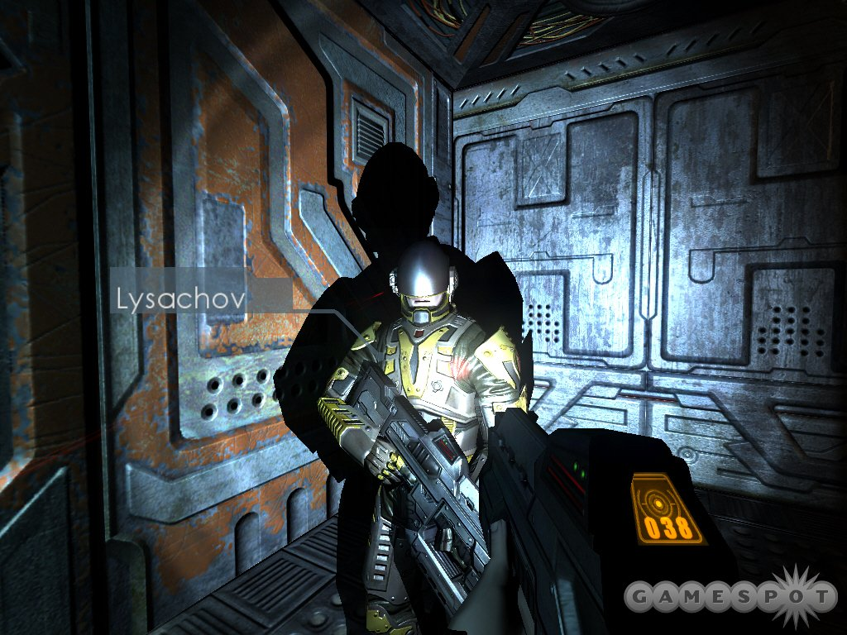


The Recent Past: The Rise of Shaders
One of the drawbacks of the early 3D API’s and by extension hardware, was a lack of fine control over the lighting models and texturing behavior.
Developers needed more control to differentiate themselves graphically from their competition.
Shaders gave this power to developers by giving them control over rendering at the vertex and pixel levels.

Slide 7




The Modern Era: Multi-Threaded Rendering, Tessellation, and the GP GPU
Modern PC’s graphics Hardware and the newly released Next Generation Consoles lead us here.
As more and more adopt new hardware and learn new techniques, the technology will become more accessible.
We are still relatively early in this phase.
This class will introduce you to Direct3D11, an API designed to take full advantage of modern hardware and rendering technology.

Slide 8

Welcome to the Mountain
D3D11
You Are Here

Slide 9



The Ascent Requires:
Extreme work ethic and
High tolerance for
Setbacks and frustration
Strong Linear Algebra
Strong C++ Skills

Slide 10


Ready? Lets Go!!!
The Good News:
Learn and Work as a Group.
Discover how 3D Graphics actually work!
What you learn here will help you in many other classes including Final Project.
Many of you will push the limits of your abilities and gain new found confidence!
Graphics are shiny! I like shiny things!
The Bad News:
The Mountain will test you as an individual, be ready!
Modern 3D Graphics can be challenging to grasp, I will simplify it as best I can.
The D3D11 API is powerful but complex.
To succeed you must be willing to devote HOURS to reading, studying and coding!

Slide 11
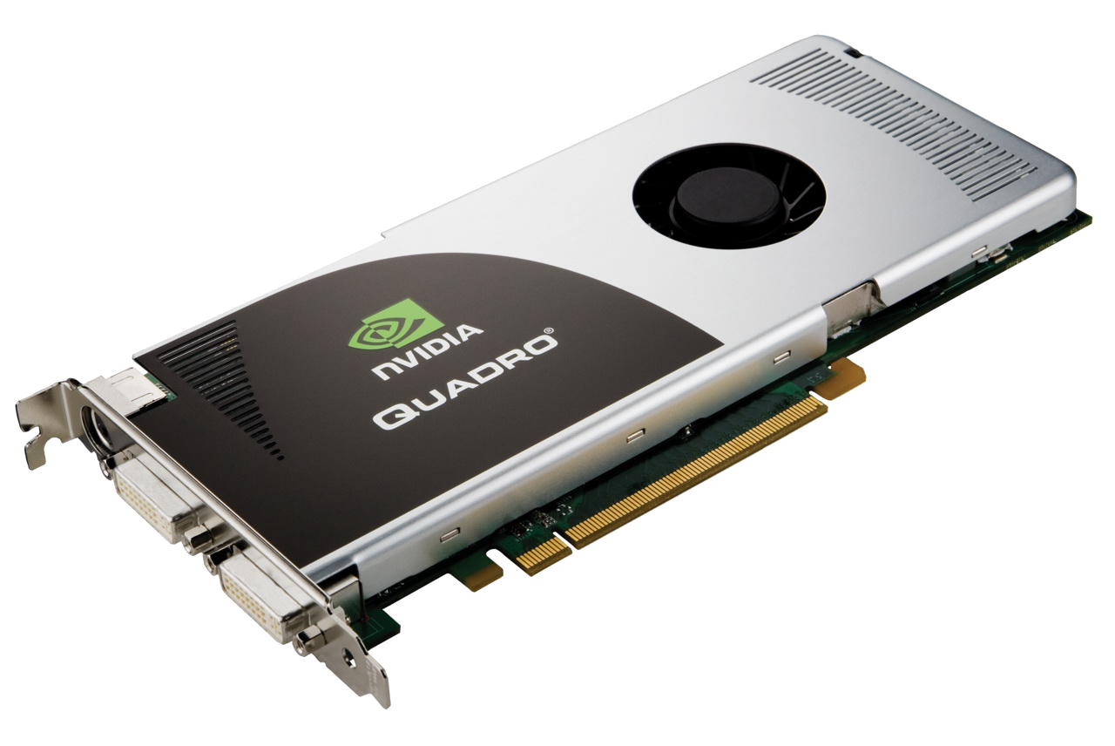


Your New Best Friends

Slide 12
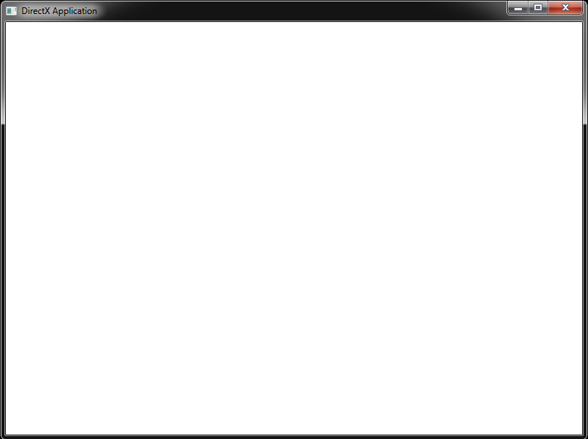
Their Target: A Win32 Window
WNDCLASSEX wndClass;
// register a new type of window
ZeroMemory( &wndClass, sizeof( wndClass ) );
wndClass.cbSize = sizeof( WNDCLASSEX );
wndClass.lpfnWndProc = ( WNDPROC )WndProc;
wndClass.lpszClassName = "DirectXApplication";
wndClass.hInstance = app;
wndClass.hCursor = LoadCursor( NULL, IDC_ARROW );
wndClass.hbrBackground = ( HBRUSH )( COLOR_WINDOWFRAME );
RegisterClassEx( &wndClass );
// create window of registered type
wnd = CreateWindow(
"DirectXApplication", "DirectX Application",
WS_OVERLAPPEDWINDOW,
CW_USEDEFAULT, CW_USEDEFAULT,
SCREEN_WIDTH, SCREEN_HEIGHT,
NULL, NULL,
app,
NULL );
ShowWindow( wnd, SW_SHOW );
UpdateWindow( wnd );
return true;

Slide 13
Initializing D3D11
Things you will need:
Include <d3d11.h> link to “d3d11.lib”
An ID3D11Device & IDXGISwapChain.
Both can be initialized with the function: “D3D11CreateDeviceAndSwapChain”

Slide 14
IDXGISwapChain
You may have noticed this object does not start with “ID3D11”.
The swap chain is part of a separate component from D3D11 called DXGI (DirectX Graphics Infrastructure), it is responsible for communicating with windows and managing the drawing area.
Typically DXGI will be used to create a 2D surface the same size as your window’s client area. Then D3D11 can be used to draw its output to that surface.
Because we don’t want to see the image while it is being drawn, DXGI will use TWO surfaces. One surface we will present to the user, the “FrontBuffer” and the other we will draw to, the “BackBuffer”. Once we are done drawing, we can “swap” the contents of the “BackBuffer” allowing continuous drawing.

Slide 15
DXGI_SWAP_CHAIN_DESC
Unused settings:
ANY initialization structures should be “zeroed out”. See “memset” or “ZeroMemory” functions. This is because common or ignored settings are often 0.
Typical Values:
Number of Buffers:
1 (FrontBuffer already exists as the “Desktop”)
BackBuffer Format:
DXGI_FORMAT_R8G8B8A8_UNORM
BackBuffer Use:
DXGI_USAGE_RENDER_TARGET_OUTPUT
Special Flags:
DXGI_SWAP_CHAIN_FLAG_ALLOW_MODE_SWITCH

Slide 16
ID3D11Device
The device is the main component of D3D11.
It is how we are able to load resources onto the graphics card and create the various interfaces used to control rendering behaviors.
Unlike previous versions of D3D, the device itself is not actually used to draw anything.
Typical uses for the device include:
Loading Geometry.
Loading Textures.
Loading Shaders.
Creating all other D3D11 Interfaces.
New to D3D11:
The device is free-threaded. Access it across threads!
This makes managing large data sets much easier!
Tip:
Use “D3D11_CREATE_DEVICE_DEBUG” in DEBUG mode.

Slide 17
What else will I need?
A couple more things are required before you can even clear the screen to a color.(Use the ID3D11Device to create them)
ID3D11RenderTargetView
This allows D3D to connect to your swap chain’s “BackBuffer” or any other draw-able surface.
ID3D11DeviceContext
There are two kinds: immediate and deferred. Create an immediate context to issue commands directly to the graphics card. This is what is actually used to draw. If you use D3D11CreateDeviceAndSwapChain one will be made for you.
D3D11_VIEWPORT
Tells D3D11 what portion of the screen/surface you want to draw to. (typically all of it)

Slide 18
What does a simple rendering Application look like?
Although we still want to process windows messages, we don’t want to wait on them in order to draw our scene in real-time.
Instead of waiting for a WM_PAINT message we just loop as fast as we can until we notice a quit message was posted.
Use PeekMessage(), as GetMessage() will make you wait for the next message before returning.
// Inside WinMain after all Initialization has taken place
while ( msg != WM_QUIT )
{
// Each iteration of this loop is known as a Frame
// During each frame…
// Gather user input
// Run Game/Application Logic
// RENDER your data to the screen
// Select the surface we want to draw to. (immediateContext)
// Clear the backbuffer/render target to a desired color (immediateContext)
// Configure the rendering pipeline (immediateContext)
// Issue drawing commands (immediateContext)
// Present the results of drawing to the FrontBuffer (SwapChain)
// get any waiting system messages and process them
if ( PeekMessage( &msg, NULL, 0, 0, PM_REMOVE ) )
{
TranslateMessage( &msg );
DispatchMessage( &msg );
}
}

Slide 19
What shapes can D3D11 rasterize?
LINES
TRIANGLES
POINTS
These simple shapes (especially triangles) can be connected together to form nearly any complex shape.

Slide 20
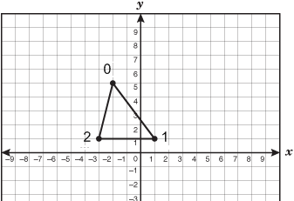
Lets draw a triangle: step 1
Create a Vertex
A vertex is a point in space representing where two edges of a triangle meet.
You need 3 vertices to draw a triangle.
A vertex may contain other data to assist in rendering such as color.
// Vertex with position & color
struct MY_VERTEX
{
XMFLOAT3 pos;
XMFLOAT4 rgba;
};

Slide 21
Lets draw a triangle: step 2
Create 3 verts to represent our triangle and copy them into a ID3D11Buffer that has been customized to hold vertices. (This buffer will end up IN VRAM)
D3D11_BUFFER_DESC::Usage
D3D11_USAGE_IMMUTABLE
D3D11_BUFFER_DESC::BindFlags
D3D11_BIND_VERTEX_BUFFER
D3D11_BUFFER_DESC::CPUAccessFlags
NULL
D3D11_BUFFER_DESC::ByteWidth
sizeof(MY_VERTEX) * 3
MY_VERTEX geometry[] =
{
{ XMFLOAT3(-0.5, 0.5,0) , XMFLOAT4(1,0,0,1) },
{ XMFLOAT3(0.5, 0.5,0) , XMFLOAT4(0,1,0,1) },
{ XMFLOAT3(0,-0.5, 0) , XMFLOAT4(0,0,1,1) }
}

Slide 22
Lets draw a triangle: step 3
Load Shaders.
I will not be going into shaders today, you may assume I will give you valid ones and show you how to load them.
Create an ID3D11InputLayout.
The Input Layout is how we tell D3D11 what kind of draw-able data it should be expecting. We will use this to define the “Layout” of a single one of our vertices.
// create input layout describing our geometry
D3D11_INPUT_ELEMENT_DESC vLayout[] =
{
{ "POSITION", 0, DXGI_FORMAT_R32G32B32_FLOAT, 0, D3D11_APPEND_ALIGNED_ELEMENT, D3D11_INPUT_PER_VERTEX_DATA, 0 },
{ "COLOR", 0, DXGI_FORMAT_R32G32B32A32_FLOAT, 0, D3D11_APPEND_ALIGNED_ELEMENT, D3D11_INPUT_PER_VERTEX_DATA, 0 }
};

Slide 23

Lets draw a triangle: step 4
After you clear the backbuffer but before you present to the screen, draw your shape.
ID3D11DeviceContext::IASetVertexBuffers
ID3D11DeviceContext::IASetInputLayout
ID3D11DeviceContext::IASetPrimitiveTopology
ID3D11DeviceContext::VSSetShader
ID3D11DeviceContext::PSSetShader
ID3D11DeviceContext::Draw

Slide 24
Constant Buffers
Another specialized type of ID3D11Buffer.
D3D11_BUFFER_DESC::BindFlags
D3D11_BIND_CONSTANT_BUFFER
These buffers are designed for sending information from your application to your shaders.
Typically you will declare structures in C++ designed to mirror any structures in a shader that contain information the shader will use directly.
Shaders and their internal structures/buffers will be given to you today.
However it is important that you know how to create the buffers themselves and update the data contained within them.

Slide 25
Creating a Constant Buffer
Constant buffers are generally split up based on how often the data contained within them is updated.
This maximizes efficiency by not updating variables needlessly when something changes.
As mentioned a constant buffer is just another ID3D11Buffer created with “CreateBuffer”.
To create a constant buffer you should know how much data it contains (typically the size of your structure) and how often you will be modifying it.

Slide 26
Updating a Constant Buffer
Two main ways:
ID3D11DeviceContext::UpdateSubresource()
Best used with a constant buffer created with D3D11_USAGE_DEFAULT that is updated intermittently.
ID3D11DeviceContext::Map() & Unmap()
An efficient way to update a constant buffer created with D3D11_USAGE_DYNAMIC that is modified constantly.
Just because you update a constant buffer does not mean it will be able to be read by the shader.
First you need to bind the buffer to the pipeline using one of the following functions based on what kind of shader is using the buffer:
ID3D11DeviceContext::VSSetConstantBuffers()
ID3D11DeviceContext::PSSetConstantBuffers()
ID3D11DeviceContext::GSSetConstantBuffers()
ID3D11DeviceContext::HSSetConstantBuffers()
ID3D11DeviceContext::DSSetConstantBuffers()
ID3D11DeviceContext::CSSetConstantBuffers()

Slide 27

Tips For Homework:
When creating verts for a shape, always specify them in a clockwise fashion.
I will explain why next time.
Want to know how to handle a WM_SIZE window resize and full-screen events?
READ THIS
Want to learn about and be able to turn on MSAA? (Multi-Sample Anti-Aliasing)
READ THIS then READ_THIS then USE_HERE
The homework will make you work with Vectors and Matrices a whole lot! Wouldn’t it be nice if a math library existed to do most of the heavy lifting?
Don’t feel bad if you find this stuff overwhelming at first. I can get frustrated by this stuff too! Just keep at it!
Some HLSL code with some colorful comments. LOL
USE THE HORSE LUKE
// What is this... I don't even...
#pragma pack_matrix( row_major ); // Nom Nom Nom
// My Eyes!!! The Goggles Do Nothing!!!
struct HLSLNOTALIGNED { float3 Wheee; float2 LOLnextRegister; }
// ARRRRRRGGGGGGGHHHHHHHHHHH!!!!!!!!!!!!!!!!!!!
cbuffer ROFLCOPTER { float4x4 whatSlotAmI_HahaYouThinkYouKnow; }

